Slide 1
Elective Recommendation System
PIP2001 Capstone Project
Batch Number: PSC192
Roll Number | Student Name
20211CSE0021 | N Shameer
20211CSE0020 | S Sreekar
20211CSE0019 | P Rahul
20211CSE0120 | T Likith Ganesh
Under the Supervision of,
Mr.Jerrin Joe Francis
Assistant Professor
School of Computer Science and Engineering
Presidency University
Name of the Program: B. Tech
Name of the HoD: Dr. Asif Md H.B
Name of the Program Project Coordinator: Mr. Amarnath J.L & Dr. Jayanthi. K.
Name of the School Project Coordinators: Dr. Abdul Khadar A

Slide 2
Introduction
Higher education institutions offer diverse elective courses, catering to various academic interests and career goals. While this diversity provides opportunities for exploration, it often overwhelms students, making course selection challenging. Many choose courses based on convenience, social influence, or pressure rather than aligning with their true interests or aspirations. This misalignment can hinder expertise development and lead to dissatisfaction. In the worst cases, students may select courses that neither excite them nor contribute meaningfully to their career paths.

Slide 3
Literature Review
Sl. no | Title | Author | Method | Advantages | Disadvantages
1. | content-based filtering draw-backs within a recommendation system | Oumaima Stitini(2021) | Singular Value Decomposition | SVD efficiently reduces dimensionality and captures latent features in large datasets. | It can be computationally expensive for very large datasets.
2. | Elective Course Recommendation System Using SVD Algorithm | Md. Mijanur Rahman (2022) | Collaborative Filtering | Helps users find the best experts, enhancing decision-making in complex scenarios. | Developing accurate systems can be complex and resource-intensive.
3. | A systematic review and research perspective on recommender systems | Deepjyoti Roy(2022) | Content-Based Filtering | Improves satisfaction by providing relevant content suggestions. | Limited interactions can affect recommendation accuracy.

Slide 4
4. | Matrix Factorization for Collaborative Filtering Recommender Systems | Jeremy Hintz(2022) | Singular Value Decomposition | Efficiently manages sparse matrices typical in large datasets with many users and items. | struggles with new users or items lacking interaction history.
5. | A Collaborative Filtering Based Approach for Recommending Elective Courses | Sanjog Ray(2023) | User-Based Collaborative Filtering | Encourages students to take electives that align with their interests, potentially improving satisfaction and performance. | Difficult to recommend courses to new students with no prior enrollment history.
6. | A Review of Recommender Systems for Choosing Elective Courses | Mfowabo Maphosa(2022) | Hybrid Systems | Saves time for both students and academic advisors by automating course selection processes. | Limited interaction data can hinder the system's ability to generate accurate recommendations.

Slide 5
7. | Automated Online Course Recommendation System using Collaborative Filtering | Ashuta Thakur(2023) | Collaborative Filtering | Collaborative filtering effectively recommends items based on user behavior and preferences. | It suffers from the "cold start" problem when there is insufficient user data.
8. | Optimized machine learning based collaborative filtering (OMLCF) recommendation system in e-commerce | J. Anitha(2022) | Collaborative Filtering | Collaborative filtering provides personalized recommendations by leveraging user-item interactions. | It can struggle with scalability and performance issues in large datasets.

Slide 6
9. | Recommendation Systems for Education: Systematic Review | María Cora Urdaneta-Ponte (2021) | Mixed Hybrid | Recommendation systems enhance user experience by providing personalized suggestions and improving engagement. | They face challenges like the "cold start" problem and potential bias in recommendations.
10. | Optimizing Parallel Collaborative Filtering | Christos Sardianos(2021) | Data Partitioning | Handles massive datasets by distributing computations across multiple machines. | Requires frequent synchronization between nodes, which can cause delays.

Slide 7
Existing method Drawback
Sparse Data in Recommendation Systems (Sparse RS’s):
Recommendation systems often face the challenge of sparse data, where there is insufficient information to make accurate predictions.
Cold Start Problem:
The cold-start problem occurs when a recommendation system lacks sufficient data for new users or items, making it difficult to generate accurate predictions.
Scalability Problems
Systems must efficiently process vast amounts of data in real time, which can be computationally expensive.

Slide 8
Proposed Method
Singular Value Decomposition (SVD) is a powerful technique used in Matrix Factorization, often employed in recommendation systems for dimensionality reduction, latent feature extraction, and making predictions about missing data. SVD is widely used to decompose a matrix (such as a user-item ratings matrix) into three separate matrices, enabling more efficient storage and better recommendations.

Slide 9
Objectives
Provide Accurate elective recommendations using SVD to align with student preferences.
Overcome the cold-start problem with matrix factorization for recommendations.
Support institutions in optimizing course planning through data-driven insights.

Slide 10
Methodology/Modules
1. Data Collection Module: Collects historical data on student elective selections and performance.
2. Data Processing Module: Preprocesses and normalizes data for analysis.
3. Recommendation Engine: Uses collaborative filtering algorithms to generate recommendations.
4. User Interface Module: Allows students to interact with the system and view suggestions.

Slide 11
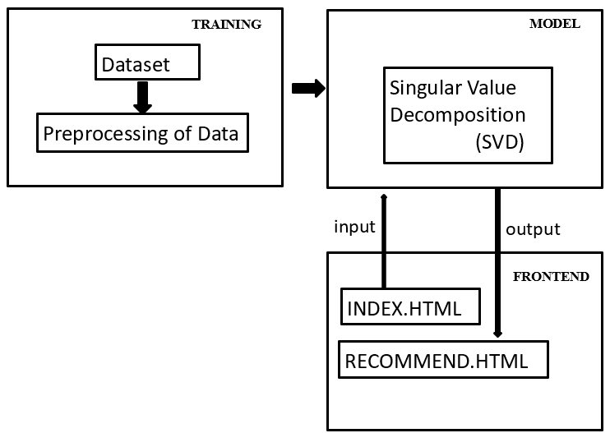
Architecture

Slide 12
Hardware/software components
1. Data Preprocessing Component:
Objective: Clean and transform the raw data to be used in the model.
1)Handle missing or incomplete data.
2)Normalize the data.
3)Format the data into a user-item matrix (for collaborative filtering).
2. Collaborative Filtering Component:
Objective: Build a model that predicts user preferences or computes similarities between courses.
1)Calculate similarity between courses or between users.
2)Implement user-user or item-item collaborative filtering algorithms.
3)Store or compute similarity matrices dynamically.

Slide 13
Expected Outcomes
1. Boosts student engagement and retention by aligning course recommendations with academic interests.
2. Enhances academic performance by guiding students toward electives suited to their strengths.
3. Provides real-time insights into course demand to support better academic planning.
4. Supports faculty and curriculum planning with data-driven insights into student interests and performance.

Slide 14
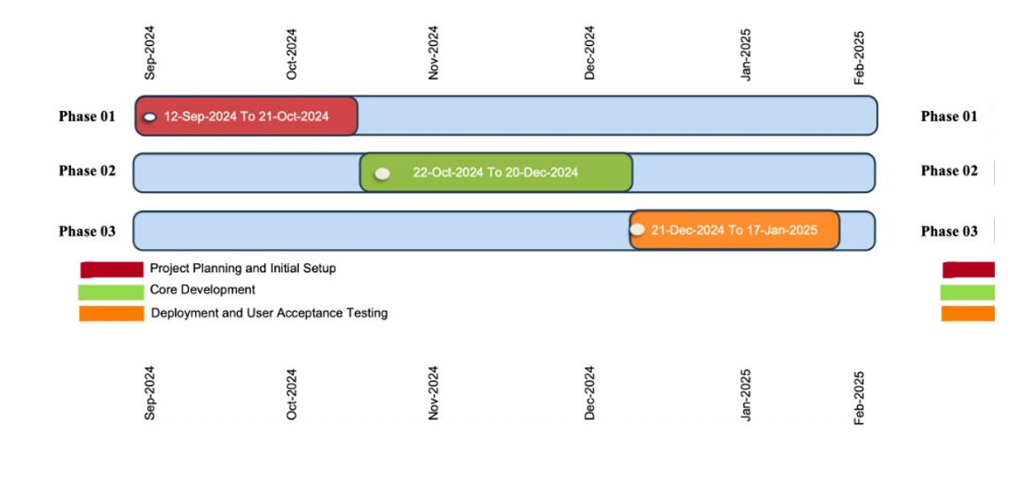
Timeline of Project

Slide 15
Conclusion
This machine learning-based recommendation system suggests elective courses for students using collaborative filtering (CF) enhanced by singular value decomposition (SVD). The system tailors recommendations by analyzing student data, such as prerequisite courses and grades, to align with academic strengths and future aspirations. Collaborative Filtering is used to find patterns in students' preferences and similarities in course choices, while SVD enhances this approach by breaking down the large, sparse matrix of course enrollments into smaller, more manageable components. This allows the system to provide accurate recommendations even when there is limited data.

Slide 16
References
[1]Mamta Kalra and Suman Sangwan (2024) ‘Machine Learning and Deep Learning Techniques for Recommendation Systems’
[2]Guldana Muzdybayeva, Dinara Khashimova, Altynbek Amirzhanov and Shirali Kadyrov (2023) ‘A Matrix Factorization-based Collaborative Filtering Framework for Course Recommendations’
[3]Jallal Talaghzi, Mostafa Bellafkih, Abdellah Bennane, Mohammed Majid Himmi and Mohammed Amraouy (2023) ‘A Combined E-Learning Course Recommender System’
[4]Jing Li1 and Zhou Ye (2020) ‘Course Recommendations in Online Education Based on Collaborative Filtering Recommendation Algorithm’
[5]Christos Sardianos, ORCID,Grigorios, Ballas Papadatos and Iraklis Varlamis (2020) ‘Optimizing Parallel Collaborative Filtering Approaches for Improving Recommendation Systems Performance’

Slide 17
References
[6] ano, Erion and Morisio, Maurizio. ‘Hybrid Recommender Systems: A Systematic Literature Review’. 1 Jan. 2019 : 1487 – 1524
[7] Koren, Y., Rendle, S., Bell, R. (2022). Advances in Collaborative Filtering. In: Ricci, F., Rokach, L., Shapira, B. (eds) Recommender Systems Handbook. Springer, New York, NY.
[8] Weiss, Stephan, et al. "Properties and structure of the analytic singular value decomposition." IEEE Transactions on Signal Processing (2024).
[9] Yang, Chen, and Qinghe Shi. "An interval perturbation method for singular value decomposition (SVD) with unknown-but-bounded (UBB) parameters." Journal of Computational and Applied Mathematics 436 (2024): 115436.
[10] Feixiang, Xie. "Intelligent Personalized Recommendation Method Based on Optimized Collaborative Filtering Algorithm in Primary and Secondary Education Resource System." IEEE Access (2024).

Slide 18
[11] Hong, Seoyoung, et al. "SVD-AE: Simple Autoencoders for Collaborative Filtering." arXiv preprint arXiv:2405.04746 (2024).
[12] He, Gongshan, Dongxing Zhao, and Lixin Ding. "Dual-embedding based Neural Collaborative Filtering for Recommender Systems." arXiv preprint arXiv:2102.02549 (2021).
[13] Budhiraja, Amar. "Revisiting SVD to generate powerful Node Embeddings for Recommendation Systems." arXiv preprint arXiv:2110.03665 (2021).
[14] Jena, Kalyan Kumar, et al. "E-learning course recommender system using collaborative filtering models." Electronics 12.1 (2022): 157.
[15] Bahar, Musthafa Zaki, and Z. K. A. Baizal. "Online Course Recommender System using Singular Value Decomposition." 2023 International Conference on Data Science and Its Applications (ICoDSA). IEEE, 2023.

Slide 19
[16] Polat, Huseyin, and Wenliang Du. "SVD-based collaborative filtering with privacy." Proceedings of the 2005 ACM symposium on Applied computing. 2005.
[17] Guan, Xin, Chang-Tsun Li, and Yu Guan. "Matrix factorization with rating completion: An enhanced SVD model for collaborative filtering recommender systems." IEEE Access 5 (2017): 27668-27678.
[18] Brand, Matthew. "Fast online svd revisions for lightweight recommender systems." Proceedings of the 2003 SIAM international conference on data mining. Society for Industrial and Applied Mathematics, 2003.
[19] Ajitsaria, Abhinav. "Build a recommendation engine with collaborative filtering." Real Python. (2019).
[20] Zhang, Sheng, et al. "Using singular value decomposition approximation for collaborative filtering." Seventh IEEE International Conference on E-Commerce Technology (CEC'05). IEEE, 2005

Slide 20
Thank You

